Slide 1
Commissioning and Operating a Direct Metal Laser Melting (DMLM) 3D Printer
Riley Shepard, Erik Leon, Sichao Jiang

Slide 2
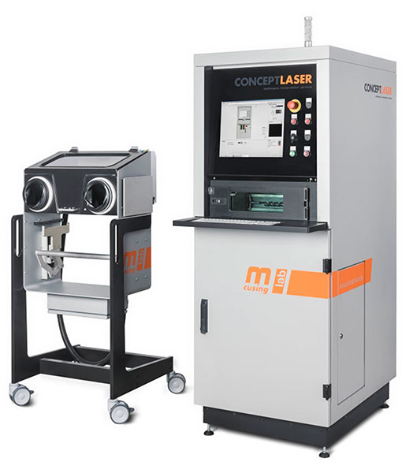
Project Description
Printer: Concept Laser MLab Cusing 100R
Final Commissioning
Start-up Guide
Safety Guidelines/Requirements
Train Idea Lab Manager
Individual Design Projects
Service- Who needs some parts made?
Client: IDEA Lab and ME Department- Dr. Ciocanel
Impact: Expand NAU's manufacturing capabilities
Mentors: Mike Downey, Justin Sokel
Figure 1: Concept Laser MLab cusing 100 R
Erik, 1

Slide 3
Commissioning Update
Complete:
Acquisition of sieve unit, wet separator, and argon gas containers
Bed leveling
Build module upgrade
Start-up of printer without powder
To Be Completed:
Purchase another tube to connect argon to sieve
Purchase metal powder (TI and SS316) to use in the printer
Operate sieve to ensure it functions properly
Begin printing test pieces to assess accuracy and complexity
Erik, 1

Slide 4
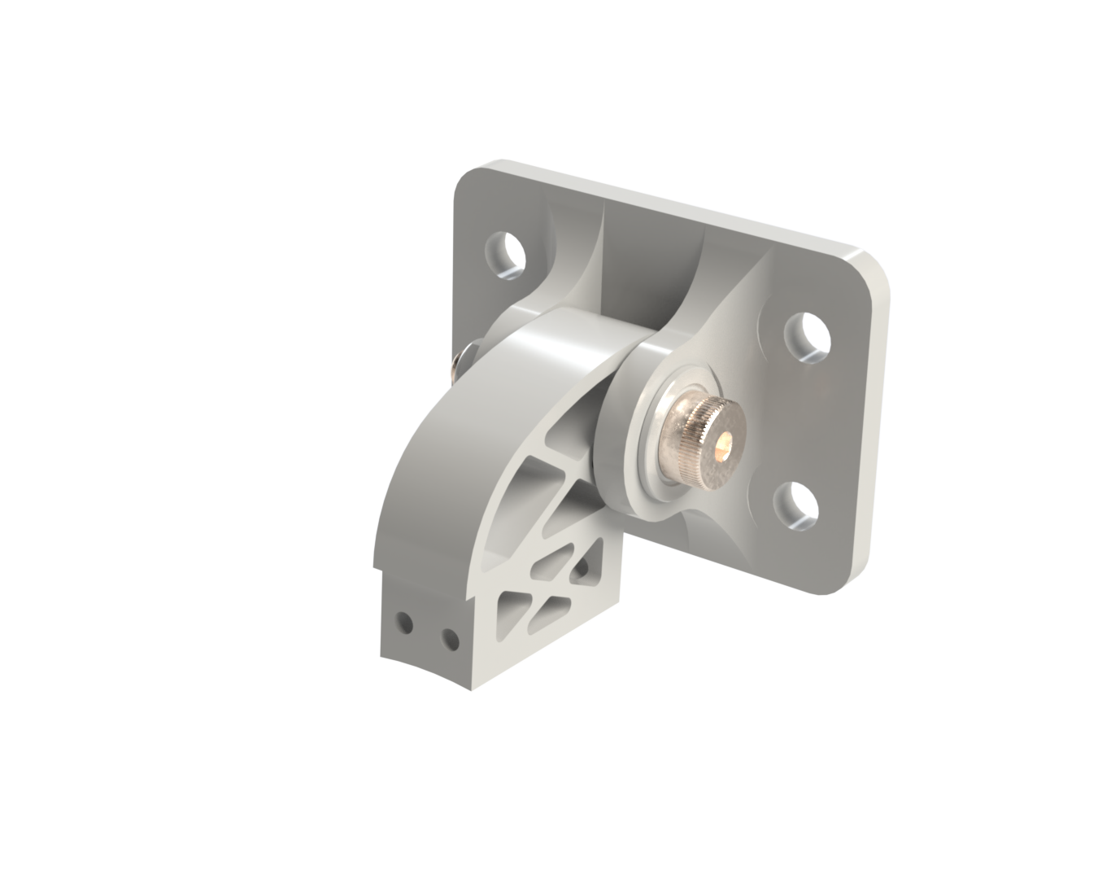
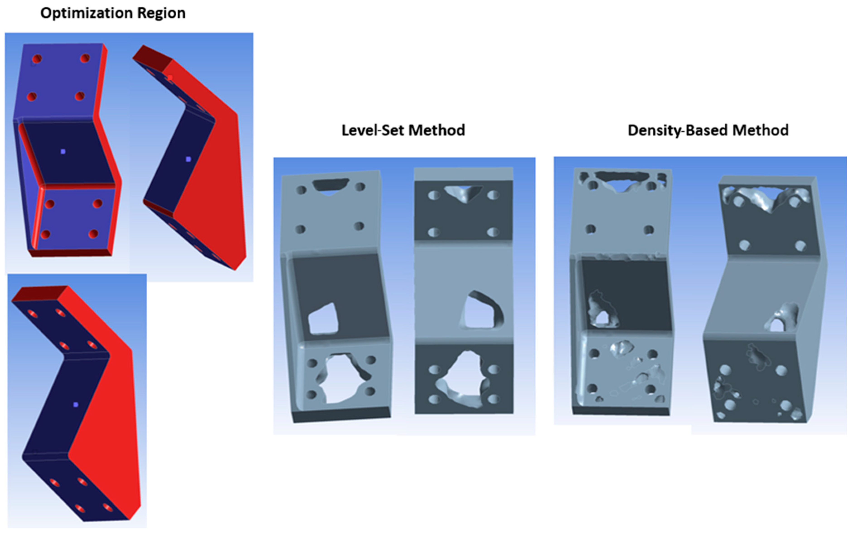
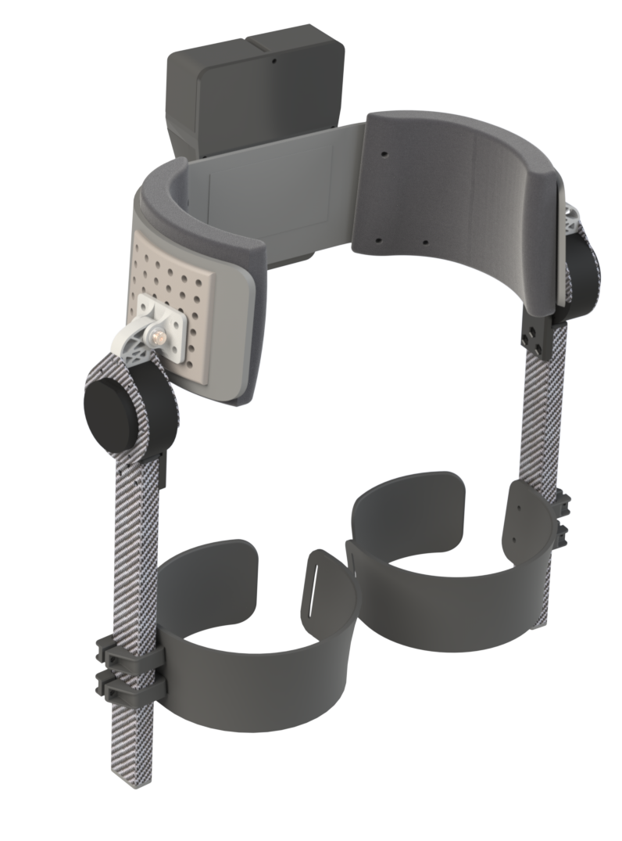
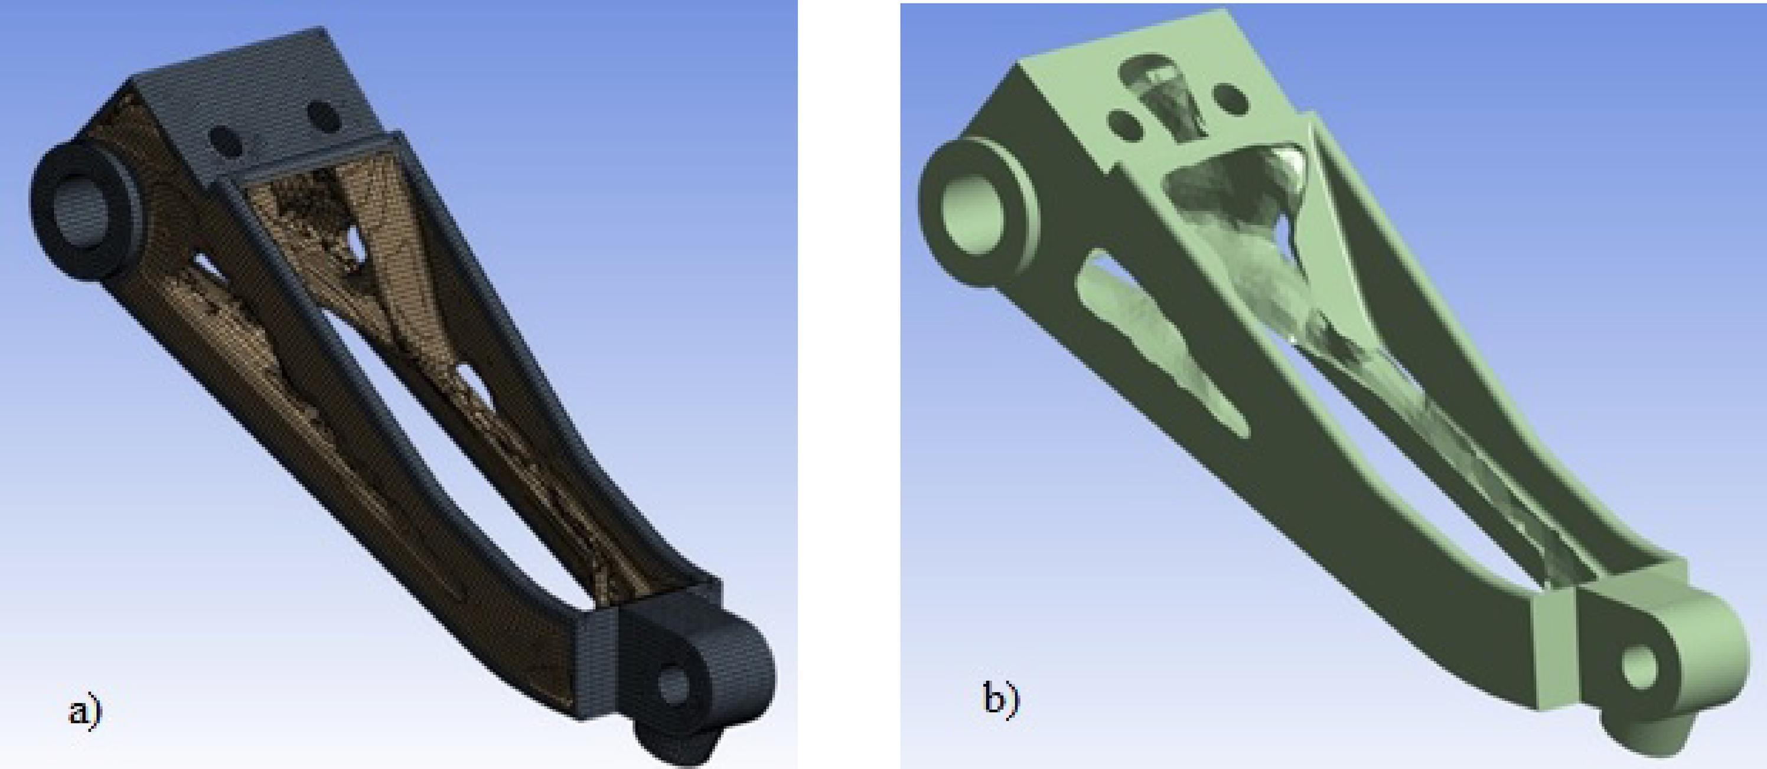
Background and Benchmarking -Riley
Background
Hip Exoskeleton Hip Abduction Bracket
Allows hip abduction DOF
Necessary for functionality and comfort
Current design
Milled
~50g
~$500 per set
7075 T6 Al
Benchmarking
[1] ] O. Okorie, et al.
Static topology optimization process of a bracket in Ansys
Shows initial design and multiple optimized models noting different constraints‌
[2] Nebojsa Raicevic et al.
Discusses parameters, constraints, and equations applied for a fatigue analysis and topology optimization for additive manufacturing
Figure 3: Topology optimized aerospace bracket [1]
Figure 4: Topology optimized aerospace torque link [2]
Figure 2: Hip Exo- Highlighting Abduction Bracket
Riley, 2

Slide 5
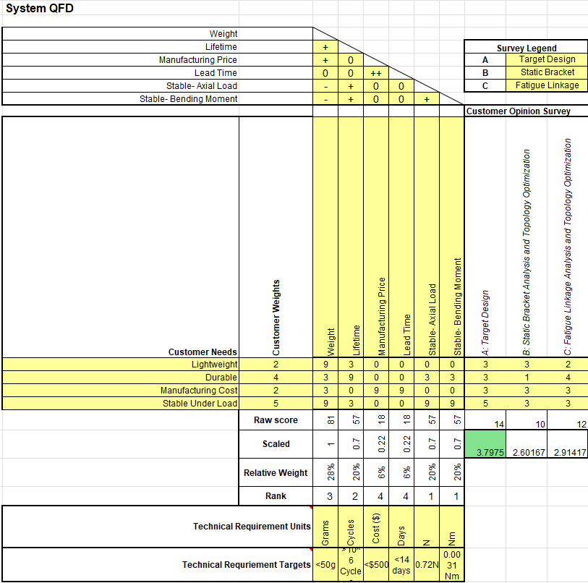
Customer & Engineering Requirements (QFD)- Riley
Table 1: Hip Exo Abduction Bracket QFD
Riley, 3

Slide 6
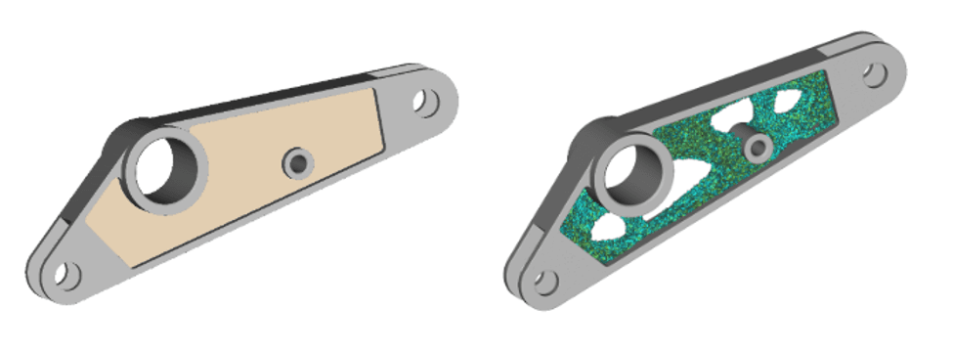

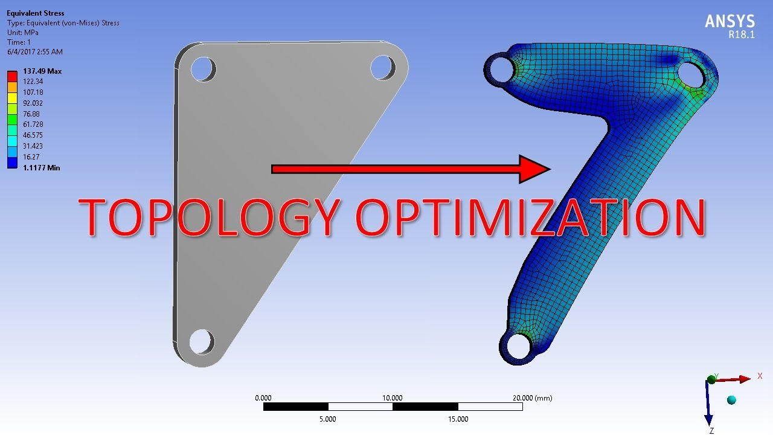
Background and Benchmarking -Erik
Background
RC Excavator Arm Segment(s)
Connects hydraulics to joints and bucket
Optimization would decrease weight and/or increasing durability
Current design
Plastic
No 'speed holes'
Benchmarking
Example brackets from nTop and Ansys
Very similar to the stick portion of the excavator
Loading conditions will vary, but optimization should be similar
Figure 5: Density-based Topology Optimization
Figure 6: Static Load-based Topology Optimization
Figure 7: RC Excavator
Erik, 4

Slide 7
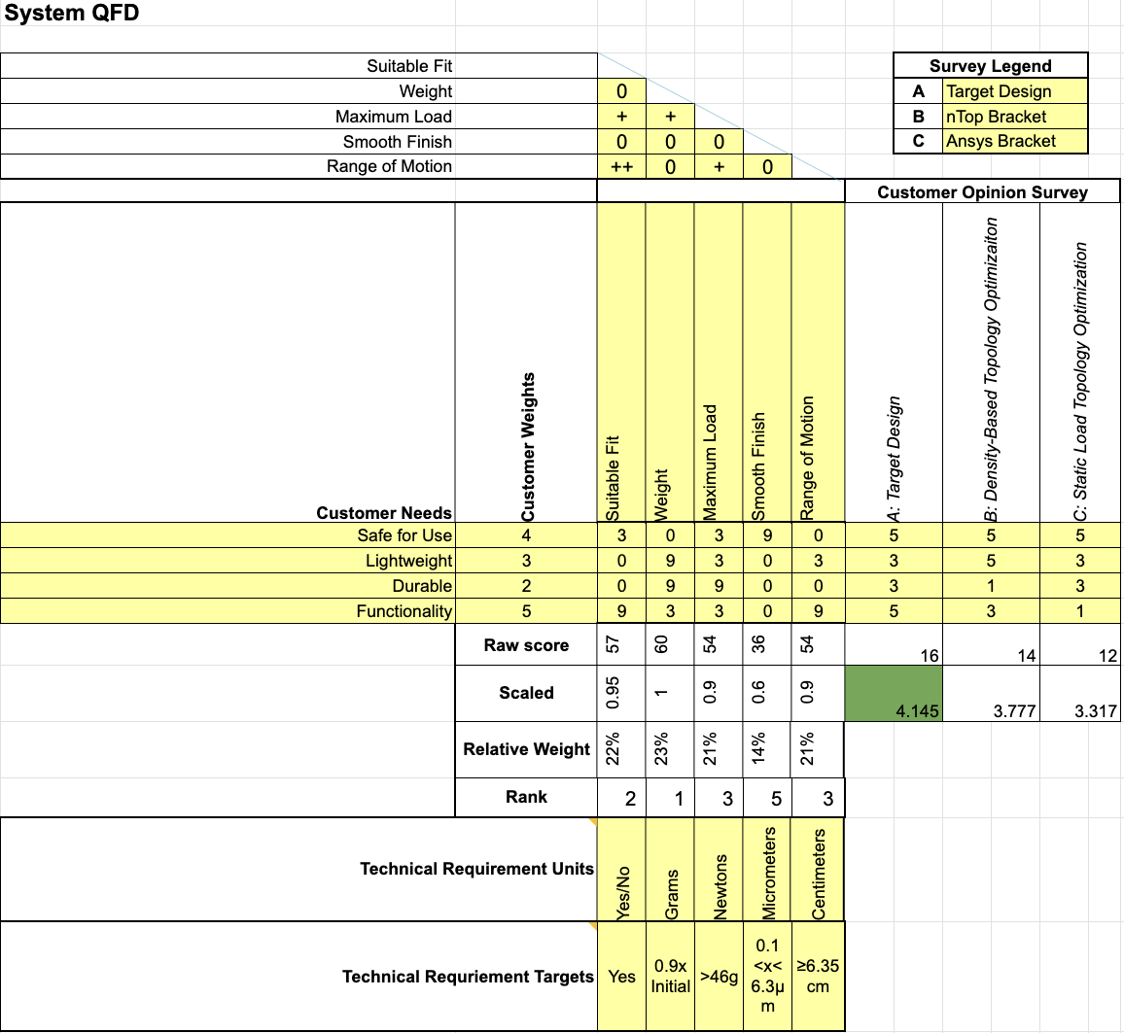
Customer & Engineering Requirements (QFD)- Erik
Table 2: RC Excavator Stick QFD
Erik, 5

Slide 8
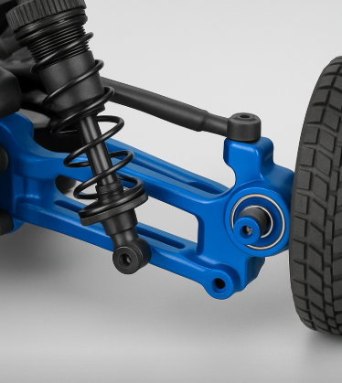
Background and Benchmarking -Sichao
Background
Function:
Supports the wheel axle and bearings
Connects suspension arm and steering link
Enables wheel steering motion
Design Requirements:
High stiffness and strength
Low weight for performance
Precise geometry for smooth steering
Benchmarking
Existing upgraded design: aluminum
Offers improved durability and steering precision
Compatible with performance suspension setups
Figure 8: Steering knuckle close-up
Sichao, 6

Slide 9
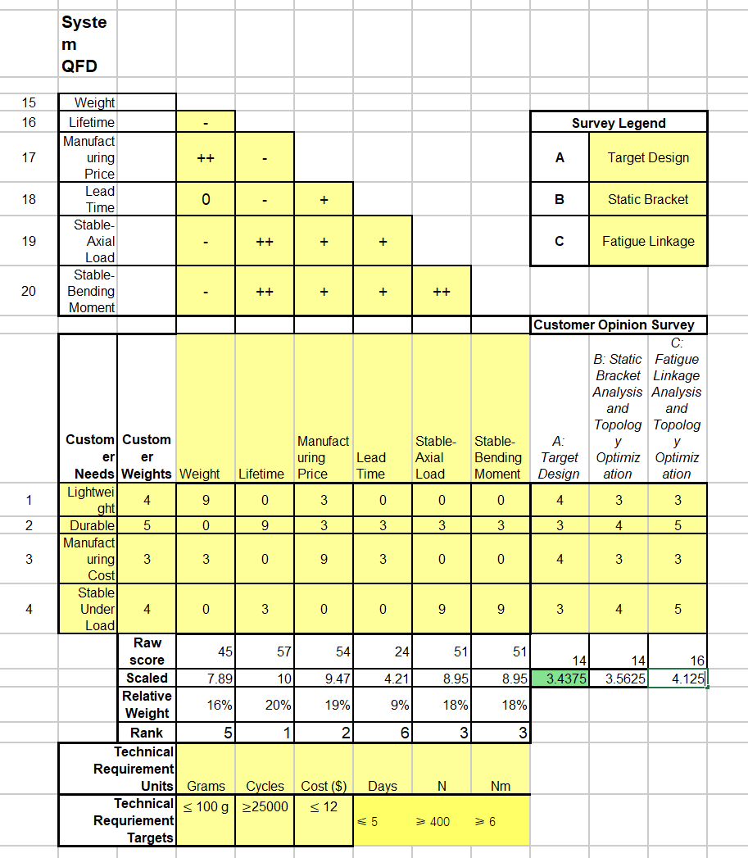
Customer & Engineering Requirements (QFD)- Sichao
Table 3
Sichao, 7

Slide 10
Literature Review- Riley
Books
[3] P. Maggiore, S. Brischetto, and C. Ferro, Additive Manufacturing Technologies and Applications. 2017.
Contains chapter titled: Overhanging Features and the SLM/DMLS Residual Stresses Problem.
Explains challenge of internal stresses caused by DMLS- will inform if annealing is required
Academic Papers
[2] Nebojsa Raicevic, Aleksandar Grbović, Gordana Kastratović, Nenad Vidanović, and A. Sedmak, “Fatigue Life Prediction of Topologically Optimized Torque Link Adjusted for Additive Manufacturing,” International Journal of Fatigue, pp. 107907–107907, Aug. 2023, doi: https://doi.org/10.1016/j.ijfatigue.2023.107907.
‌Contains information of a fatigue life analysis and topology optimization of an aircraft torque link
[4] D. Jankovics, H. Gohari, M. Tayefeh, and A. Barari, “Developing Topology Optimization with Additive Manufacturing Constraints in ANSYS®,” IFAC-PapersOnLine, vol. 51, no. 11, pp. 1359–1364, Jan. 2018, doi: https://doi.org/10.1016/j.ifacol.2018.08.340.
Discusses the implementation of additive manufacturing constraints on topology optimization using ANSYS
Constrained based on AM overhang sensitivities
[1] O. Okorie, A. Perveen, D. Talamona, and K. Kostas, “Topology Optimization of an Aerospace Bracket: Numerical and Experimental Investigation,” Applied Sciences, vol. 13, no. 24, p. 13218, Jan. 2023, doi: https://doi.org/10.3390/app132413218.
Contains information of a static loading case and topology optimization for a bracket
Websites
[5] “Design for Metal Additive Manufacturing Part 2: Topology Optimization and Build Preparation,” Ansys.com, 2023. https://www.ansys.com/academic/educators/education-resources/am-case-study-part-2 (accessed Sep. 15, 2025).
Tutorial for completing a simple topology optimization for additive manufacturing
[6]“Safety management in metal Additive Manufacturing,” Metal Additive Manufacturing, Mar. 01, 2019. https://www.metal-am.com/articles/safety-management-in-metal-3d-printing/
‌Explains many safety factors concerning metal powder
Includes recommendations for powder handling and accident prevention
Standards
[7] “Specification for Additive Manufacturing Stainless Steel Alloy (UNS S31603) with Powder Bed Fusion,” Sep. 2016, doi: https://doi.org/10.1520/f3184-16.
Looks at 2 different processes for DMLS AM and discusses operational standards to achieve improved material properties
Riley, 8

Slide 11
Literature Review- Erik
Physical Manual
[8] Mlab cusing R: Translation of Operating Manual, v1.0.15, CONCEPT Laser GmbH, 2013, S1 pp.10-141
Safety information and step-by-step tutorial on how to operate the metal 3D printer
[9] Instruction Manual: Wet Separator, v1.0.15, CONCEPT Laser GmbH, June 2014, S3 pp.7-39
Safety information and step-by-step tutorial on how to operate the wet separator
[10] Mlab cusing: Concept Laser Software 1.2.4, v1.0.15, CONCEPT Laser GmbH, 2013, S4 pp.7-39
Tutorial for printer software and troubleshooting
E-Manual
[11] QM Powder: Automatic Sieving Station Operation Manual, v1.0.15, CONCEPT Laser GmbH, July 12, 2016. Accessed Sept. 16, 2025. [Online] Available: https://www.prestigeequipment.com/pix/29314.pdf
Safety information and step-by-step tutorial on how to operate the sieve unit
Website
[12] nTop, “How to get the most out of topology optimization,” nTop, Mar. 19, 2020. https://www.ntop.com/resources/blog/how-to-get-the-most-out-of-topology-optimization/
Describes nTop's optimization process
[13] The Engineering Toolbox, “Young’s Modulus - Tensile and Yield Strength for common Materials,” Engineeringtoolbox.com, 2003. https://www.engineeringtoolbox.com/young-modulus-d_417.html
Provides properties of metals that will be tested
Article
[14] R. M. Dhawale and S. R. Wagh, “FINITE ELEMENT ANALYSIS OF COMPONENTS OF EXCAVATOR ARM—A REVIEW,” Jan. 2014. https://www.ijmerr.com/v3n2/ijmerr_v3n2_40.pdf
A review of various analyses done on parts of an excavator
‌
Erik, 9

Slide 12
Literature Review- Sichao
[15] ISO/ASTM International, “Additive manufacturing — Design — Requirements, guidelines and recommendations,”
https://www.iso.org/standard/67289.html
[16]ISO/ASTM International, “Additive manufacturing of metals — Process characteristics and performance — Metal powder bed fusion process to meet critical applications,”
https://www.iso.org/standard/82919.html
[17] ISO/ASTM International, “Additive manufacturing — Feedstock materials — Methods to characterize metal powders,”
https://www.iso.org/standard/73565.html
[18] ISO/ASTM International, “Additive manufacturing of metals — Finished part properties — Post-processing, inspection and testing of parts produced by powder bed fusion,”
https://www.iso.org/standard/81779.html
[19] ISO/ASTM International, “Additive manufacturing — Test artefacts — Geometric capability assessment of additive manufacturing systems,”
https://www.iso.org/standard/67287.html
[20] ASTM International, “Standard Specification for Additive Manufacturing Titanium-6 Aluminum-4 Vanadium with Powder Bed Fusion,”
https://www.astm.org/f2924-14r21.html
[21] ASTM International, “Additive Manufacturing – Finished Part Properties – Specification for AlSi10Mg with Powder Bed Fusion – Laser Beam,”
https://www.astm.org/f3318-18.html
Sichao, 10

Slide 13
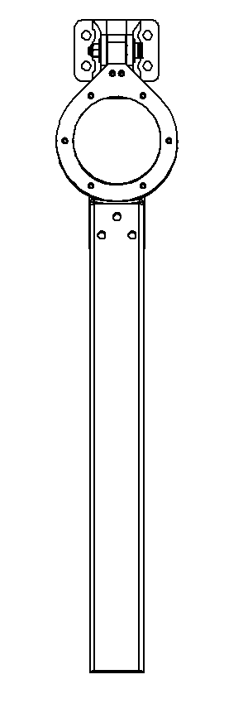
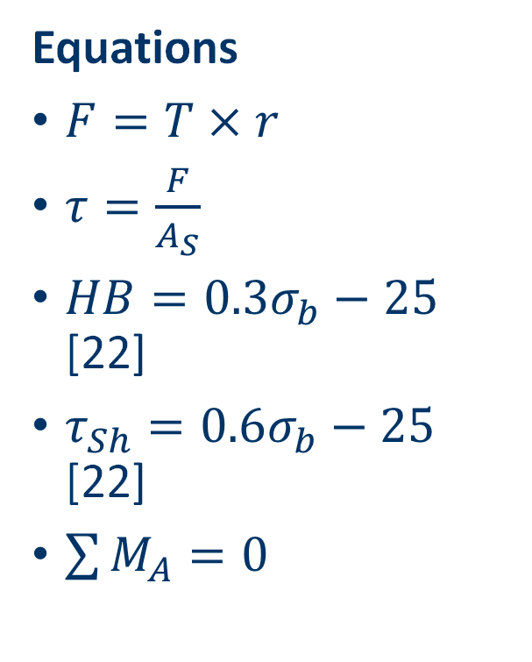
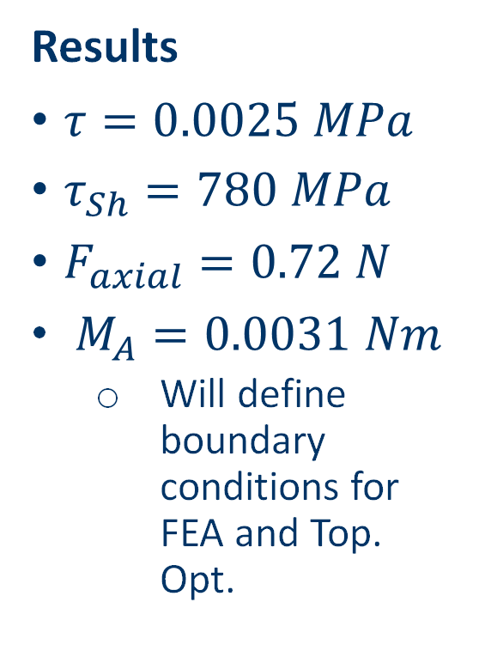
Hip Bracket Mathematical Modelling
Known Parameters and Assumptions
Max Operational Torque at Motor:
12 Nm
Known Distances:
60mm- axis to axis
44mm- motor axis to mounting screws
Alloy Steel M3 screws
Assumptions:
Upright, carbon fiber motor brackets, and baseplate rigidly fixed
All 4 bolts loaded equally
Equations
$F=T×r$
$τ=\frac{F}{A_{S}}$
$HB=0.3σ_{b}−25$ [22]
$τ_{Sh}=0.6σ_{b}−25$ [22]
$\sum{M_{A}=0}$
Results
$τ=0.0025 MPa$
$τ_{Sh}=780 MPa$
$F_{axial}=0.72 N$
$M_{A}=0.0031 Nm$
Will define boundary conditions for FEA and Top. Opt.
Figure 9: Motor Torque Diagram
Riley, 11

Slide 14
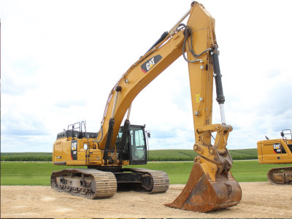
RC Excavator Stick Mathematical Modelling
Expected Loads and Conditions
Torque at connections to boom and bucket
Variable based on extension of arm
Momentum from bucket and general movement
Equations
τ = r × F
p = mv
ΣM = 0
Results
τ = 6.137x10^-4 Nm
p = .002 kgm/s
Figure 10: Excavator Arm Example
Erik, 12

Slide 15
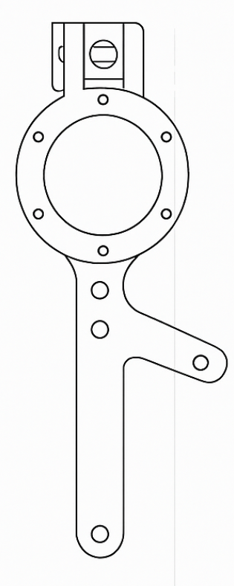
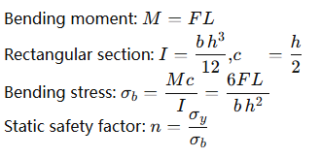
Mathematical Modelling (Sichao)
Component: Steering Block
Load case: lateral/landing load transmitted at wheel axle → knuckle
Lever arm to critical section: L=25 mm
Resultant force at axle (model): F=150 N
Section at neck (approx.): width b=6 mm, thickness h=12 mm
Material: 7075-T6, yield σy≈505 MPa
Notes: dominant bending; torsion/shear checked in FEA
Equation：
Results：
M=150×0.025=3.75N*m
σb =（6×150×0.025）/
（0.006×（0.012）^2)=26MPa
n=505/26≈19
Figure 11: Steering Knuckle Drawing
Sichao, 13

Slide 16
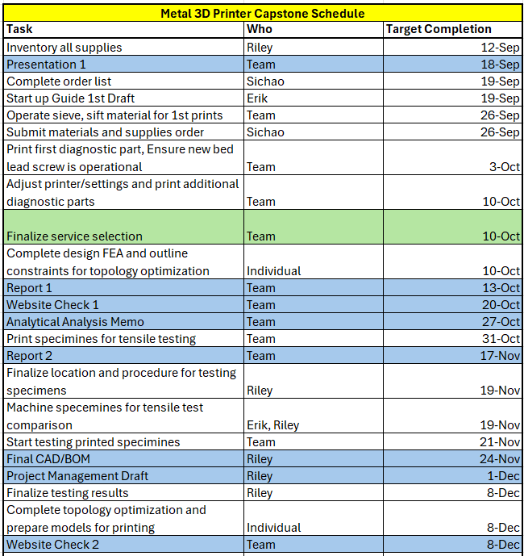
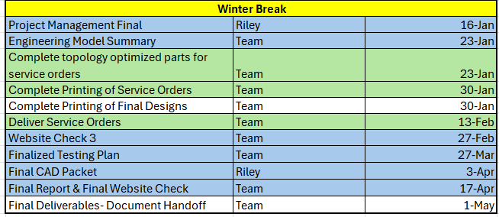
Schedule
Table 4: Team Task List and Schedule
Riley, 14

Slide 17
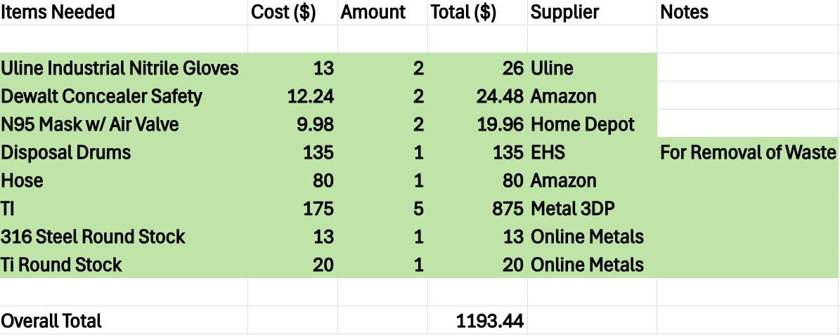
Budget
Fundraising Plans
Monetary Goal: ~$120
Team will finalize after verifying BOM with Dr. Ciocanel
Potential Opportunities:
Team GoFundMe
Restaurant fundraising night
Cane's
Chipotle
Table 5: Bill of Materials
Sichao, 15

Slide 18
Thank you And Any Questions?

Slide 19
Additional References
[22]Georgi Genov, “REVISITING THE RULE-OF-THUMB DEPENDENCIES OF THE SHEAR STRENGTH AND THE HARDNESS ON THE YIELD AND THE ULTIMATE STRENGTHS,” Nov. 17, 2020. https://www.researchgate.net/publication/355208819_REVISITING_THE_RULE-OF-THUMB_DEPENDENCIES_OF_THE_SHEAR_STRENGTH_AND_THE_HARDNESS_ON_THE_YIELD_AND_THE_ULTIMATE_STRENGTHS
‌

Slide 20
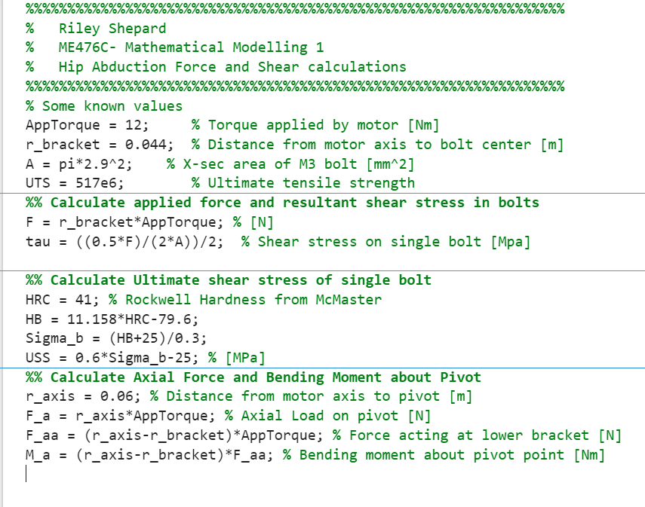
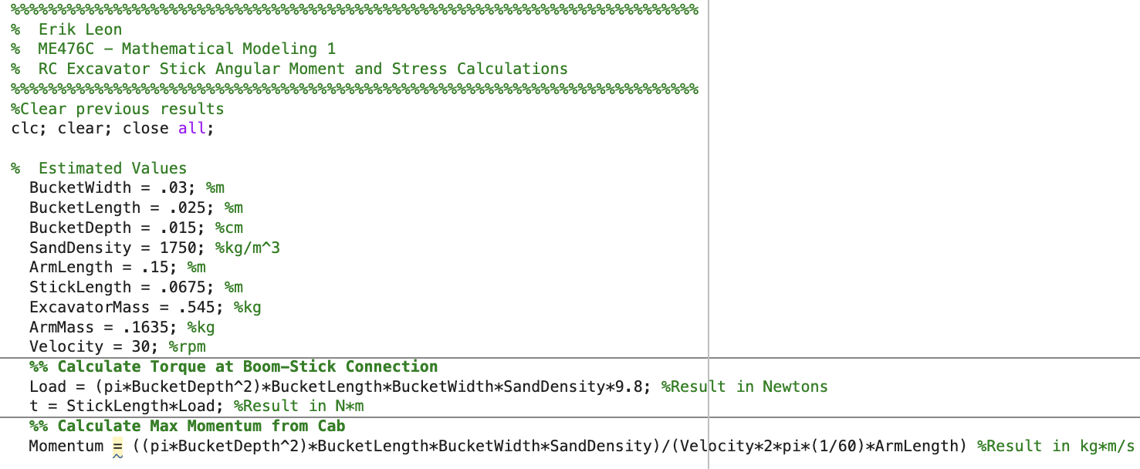
Appendix
Figure 12: Hip Abduction Bracket Force and Shear Calculations
Figure 13: RC Excavator Stick Torque and Momentum Calculations

Slide 21
Hip Abduction Bracket
Motor
Applied Motor Torque (10Nm)
Upright

